Slide 2
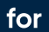

SKIPPING ACROSS BAYESIAN LEARNING
ENGINEERING MACHINE LEARNING
HEALTH TECHNOLOGY

Slide 3
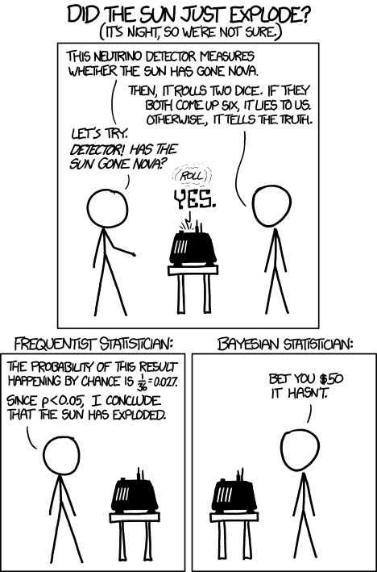
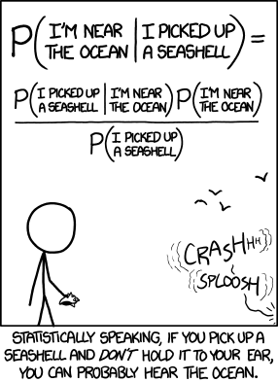
Bayesian METHODS

Slide 4
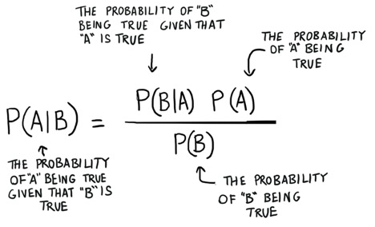
Bayesian METHODS
BAYES THEOREM

Slide 5
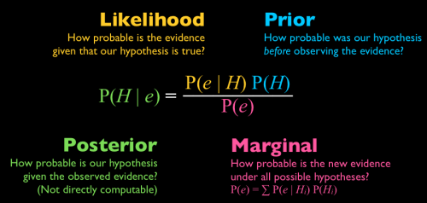
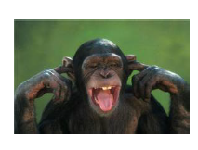

Bayesian METHODS
TERMINOLOGY
Mr. SWMAL
Dr. STMAL

Slide 6
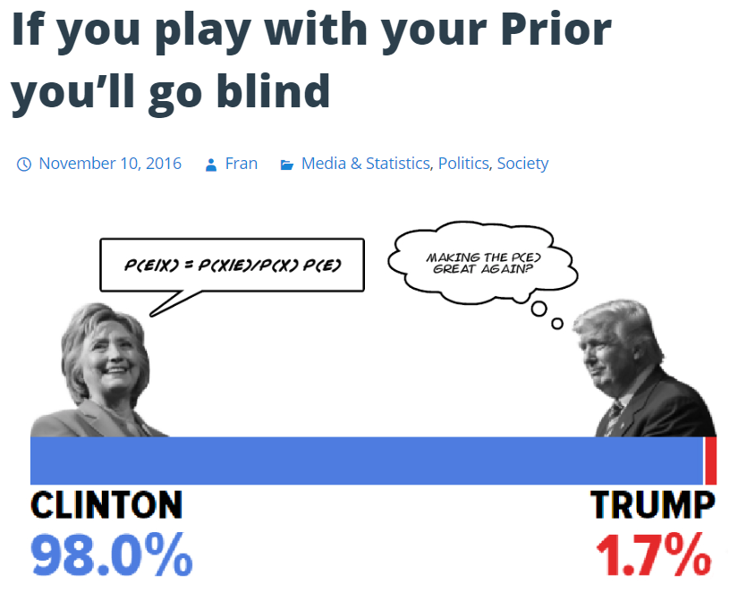
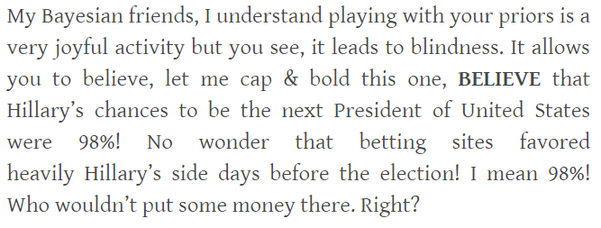
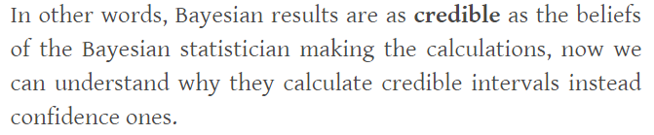
Bayesian METHODS

Slide 7
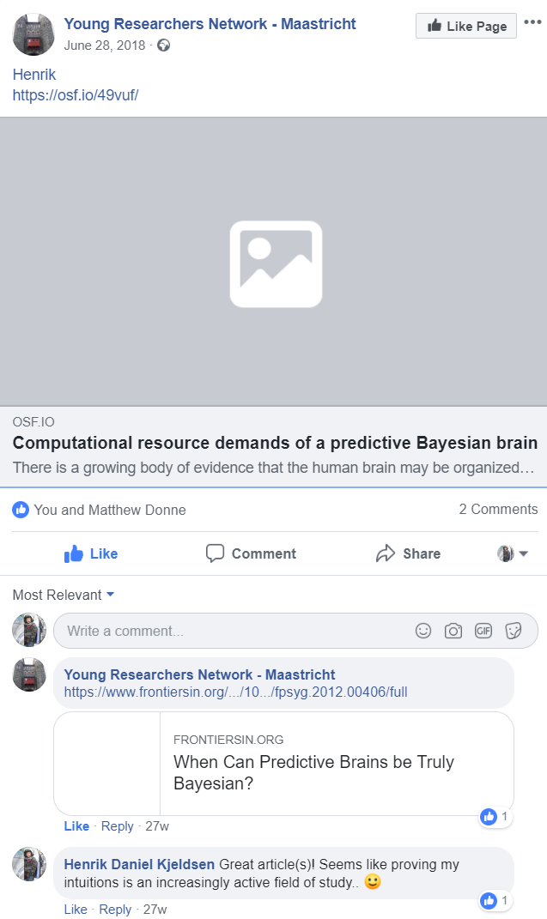
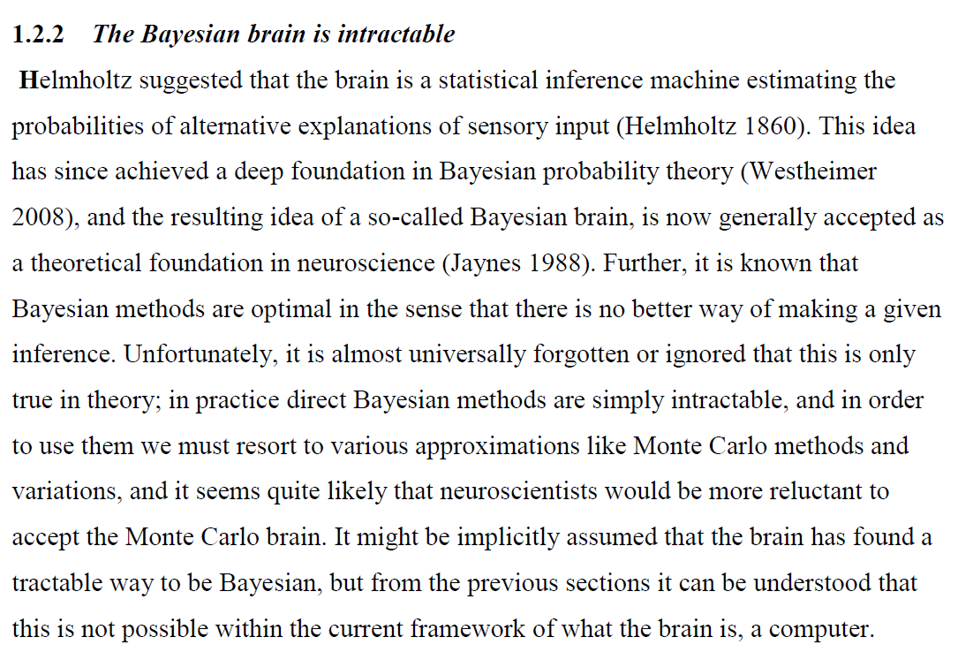

The Bayesian brain hypothesis
Kjeldsen, 2013

Slide 8
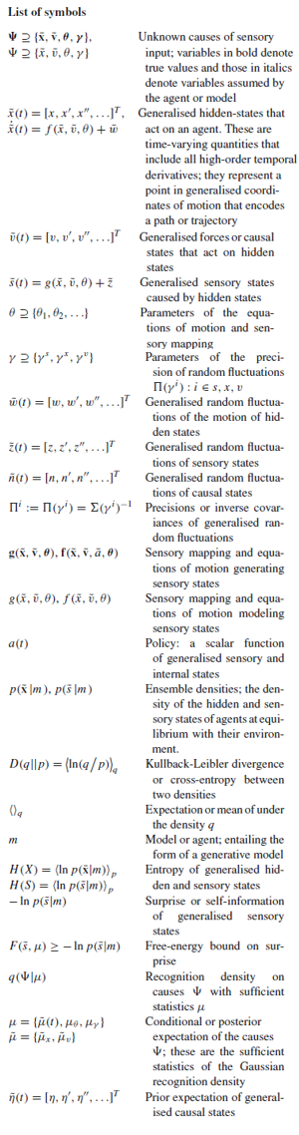
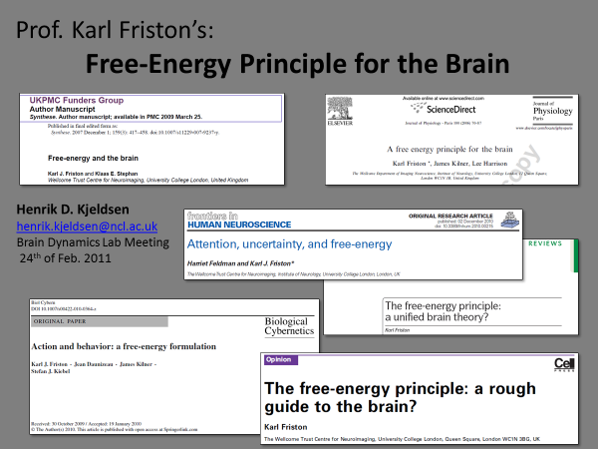
The Bayesian brain hypothesis

Slide 9
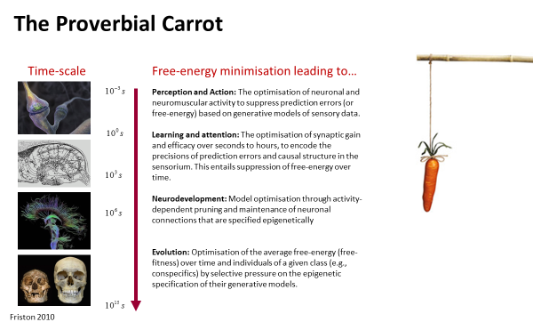
The Bayesian brain hypothesis

Slide 10
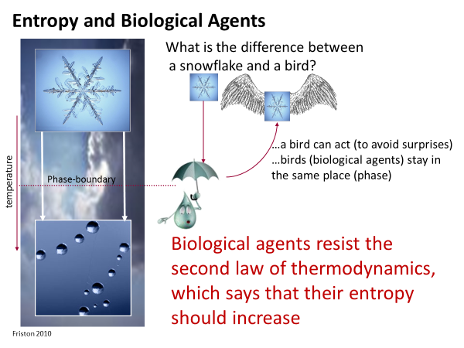
The Bayesian brain hypothesis
“We can succinctly say that it appears
that brains are to white holes as stars are to black holes (in terms of entropy).” Kjeldsen 2013

Slide 11
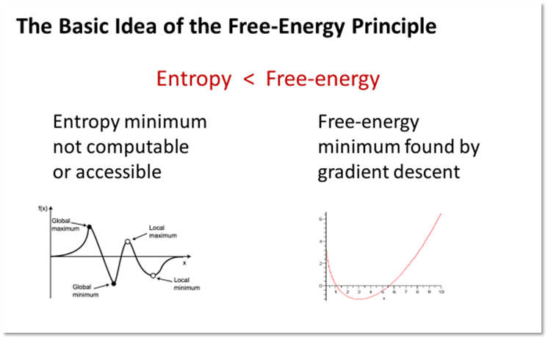
The Bayesian brain hypothesis

Slide 12
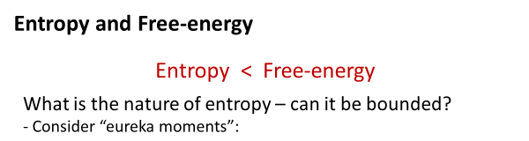
The Bayesian brain hypothesis

Slide 13
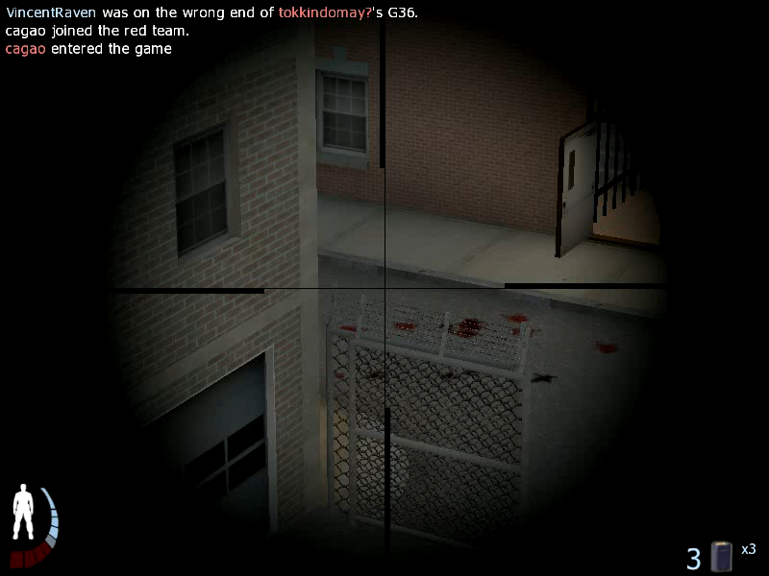
Reverse engineering of INSIGHT

Slide 14
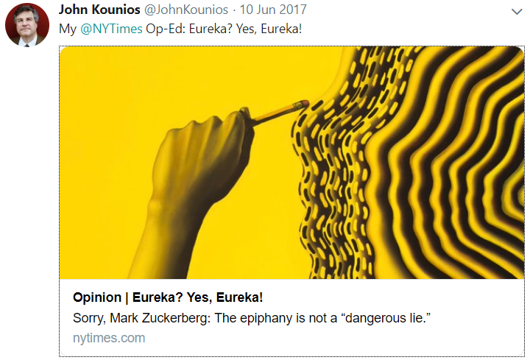

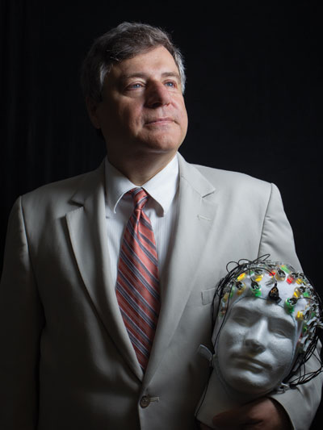
Reverse engineering of INSIGHT
NEW EXPERIMENT

Slide 15
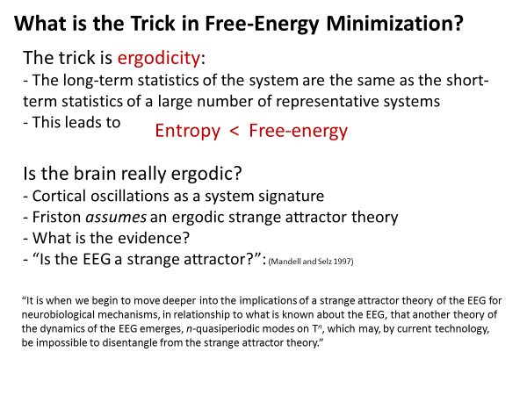
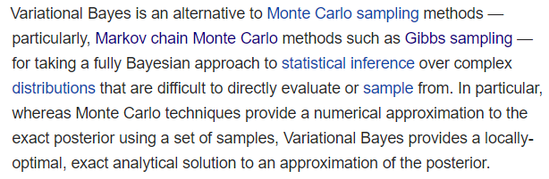
The Bayesian brain hypothesis

Slide 16
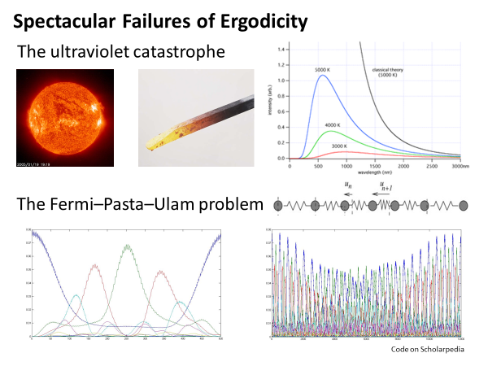
The Bayesian brain hypothesis

Slide 17
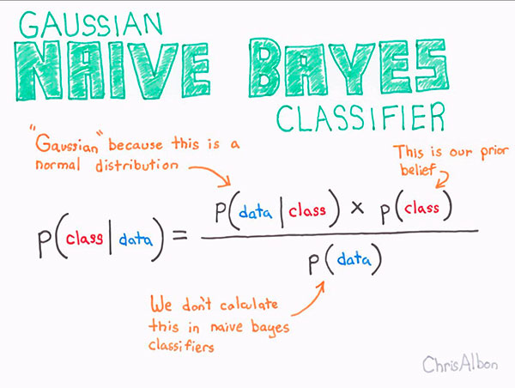
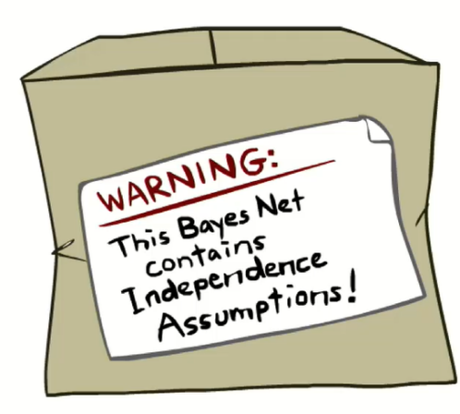
The Bayesian brain hypothesis

